Slide 1




HIGHCLOUD AIRLINES
*Anchal Singh *Boguda Devendranath * Monika Rathore *Byreddy *Bharathi *Ankit

Slide 2
The objective of this project is to provide a comprehensive analysis of airline operations for High Cloud, focusing on key performance metrics such as the load factor, passenger preferences, and route efficiency. The dashboard presents data on the total number of airlines, passengers, available seats, and total distance traveled. It further breaks down performance by carrier name, top flight routes, distance groups, and load factor trends across years. Additionally, it highlights passengers' preferences while traveling on weekday vs weekends.
OBJECTIVES

Slide 3






TABLE OF CONTENTS
EXCEL
POWER BI
TABLEAU
MYSQL

Slide 4


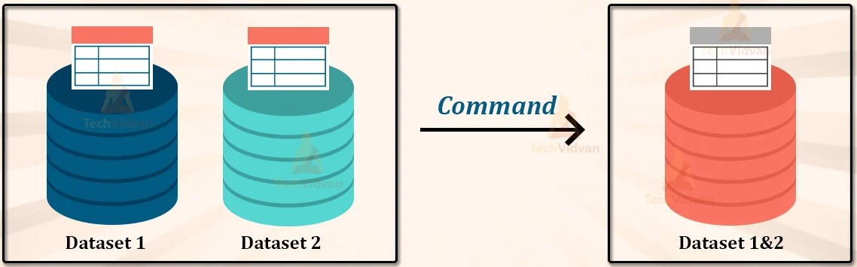
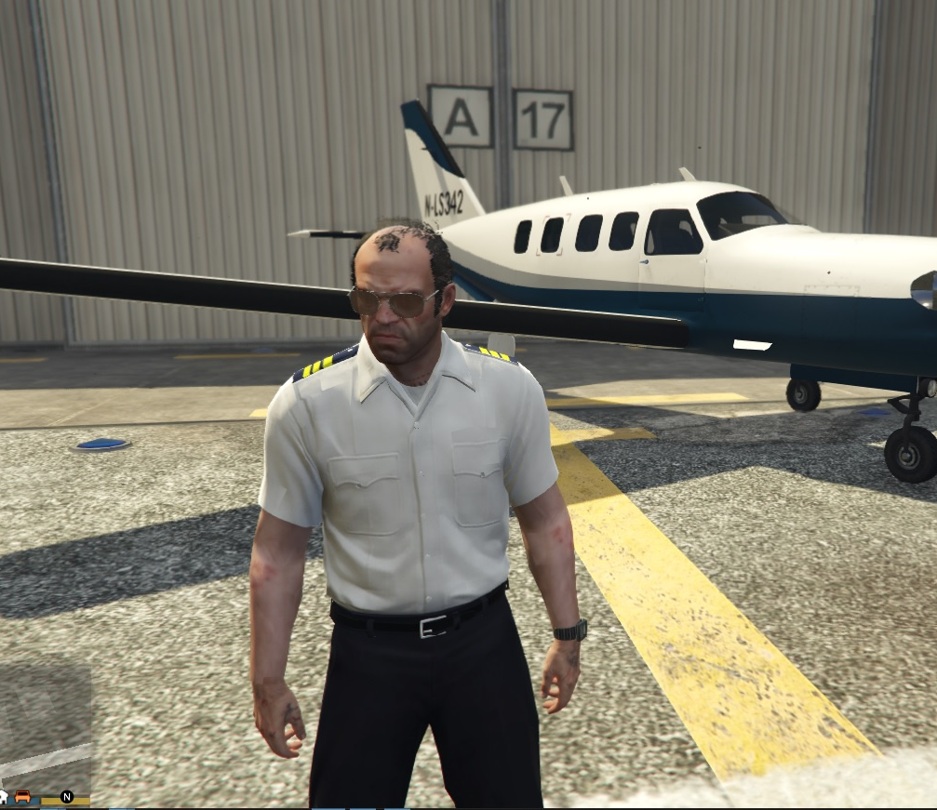

TASKS
DATA CLEANING
MERGING DATASETS
INTERACTIVE DASHBOARDS

Slide 5
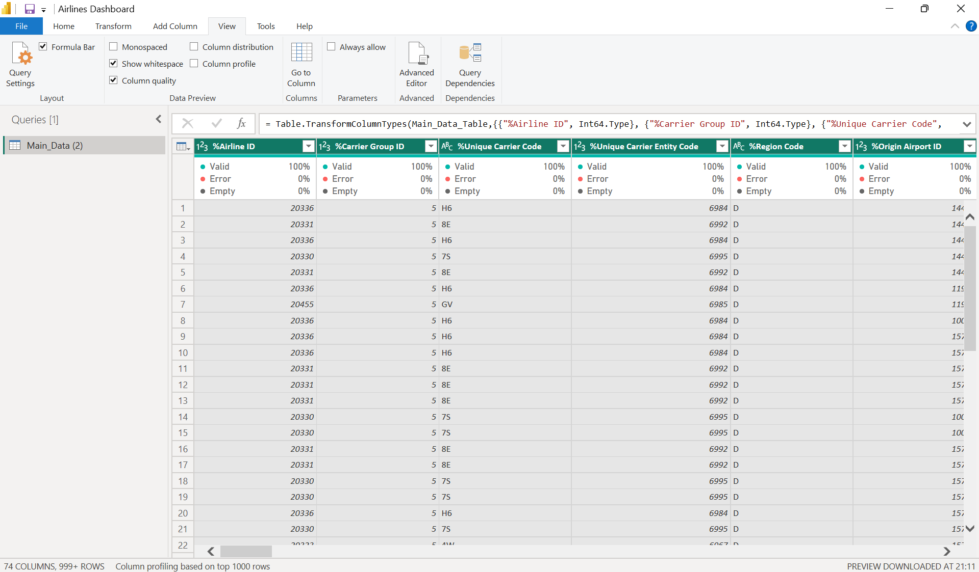
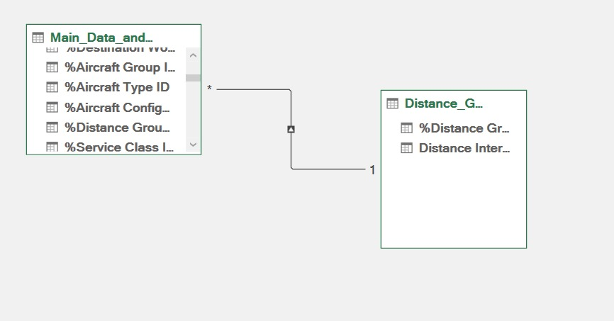
DATA TRANSFORMATION
Data wrangling is the process of converting raw data into a usable form. It may also be called data munging or data remediation. We suppose to remove the empty column, find and replace the error values, removing null values and correct the values wherever required and check the column quality and make it completely structured.
Data integration refers to the process of combining and harmonizing data from multiple sources into a unified, coherent format that can be put to use for various analytical, operational and decision-making purposes example: Data Modeling

Slide 6
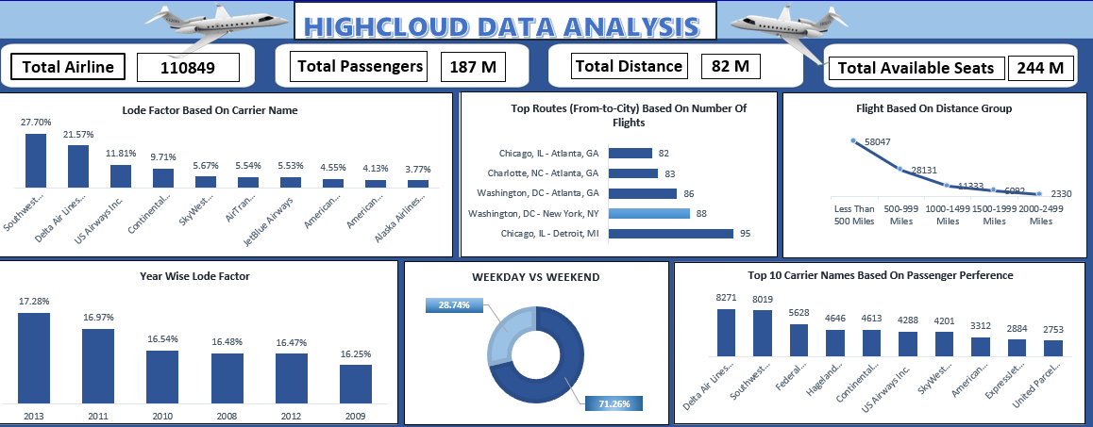
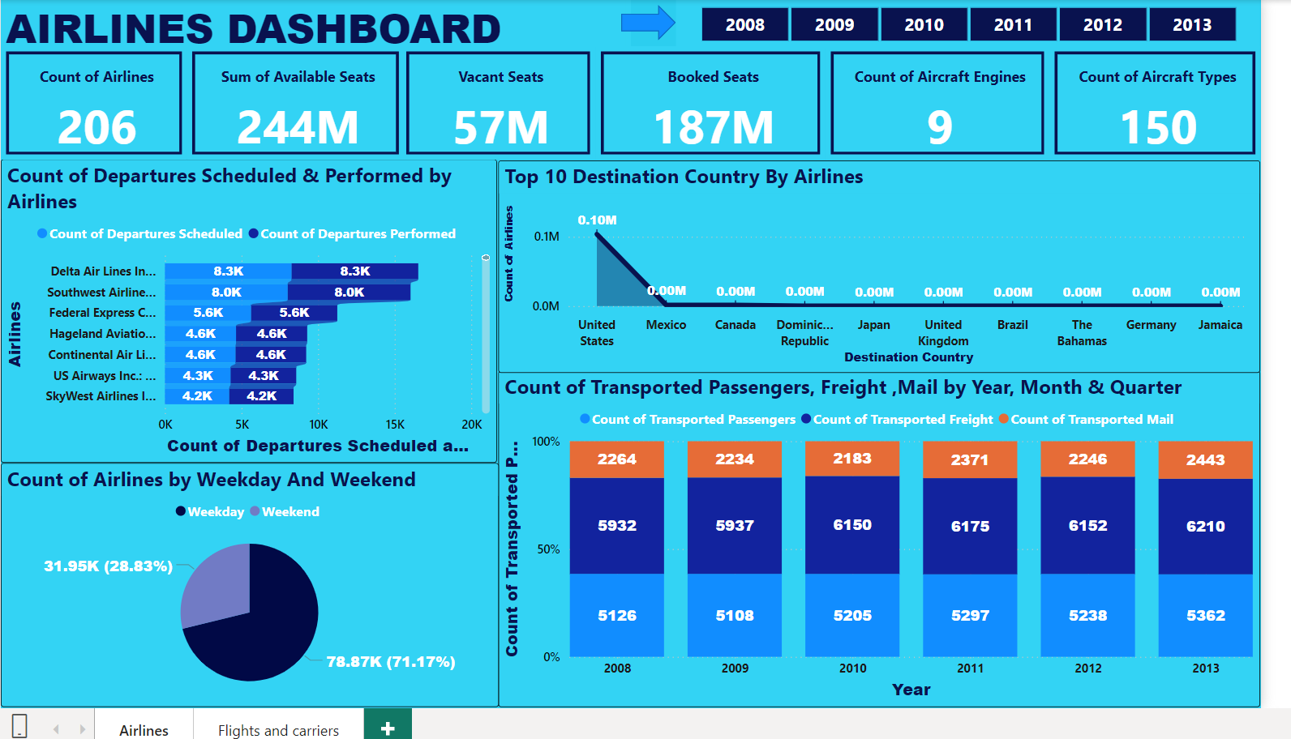
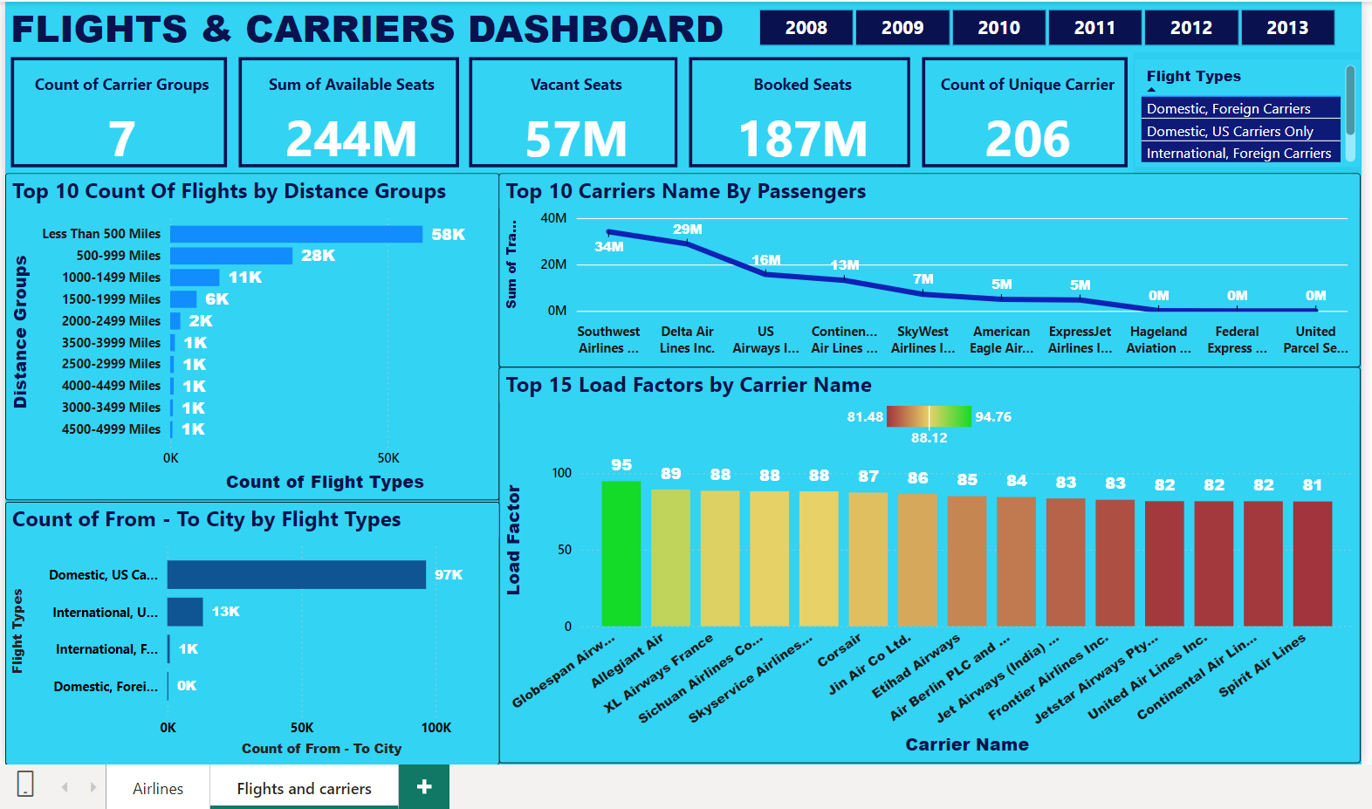
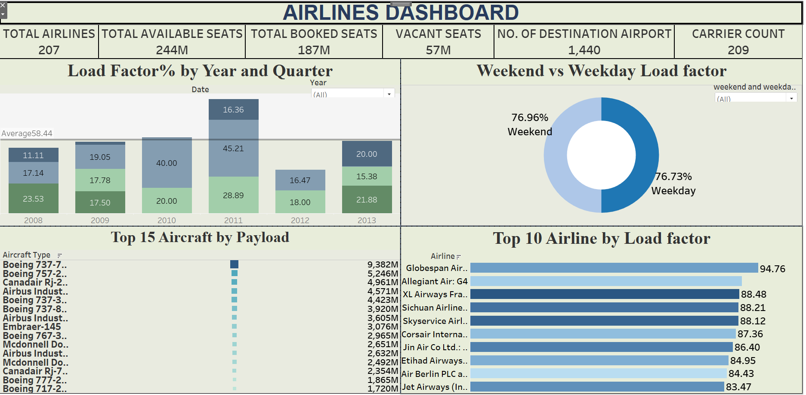
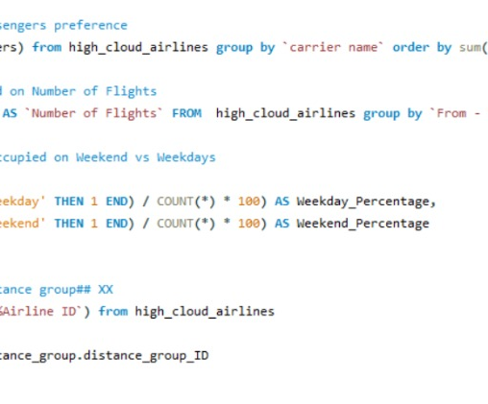
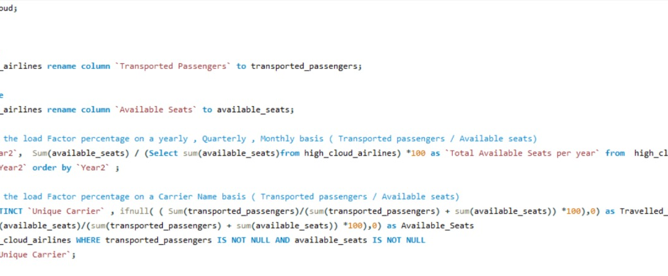

DASHBOARD

Slide 7
EXCEL DASHBOARD

Slide 8
POWER BI DASHBOARD

Slide 9
POWER BI DASHBOARD

Slide 10
TABLEAU DASHBOARD

Slide 11
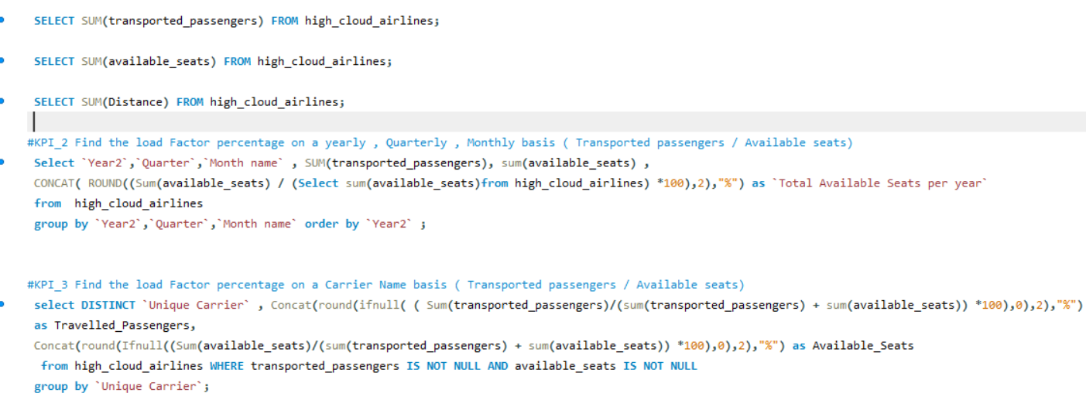
SQL QUERY VISUAL

Slide 12
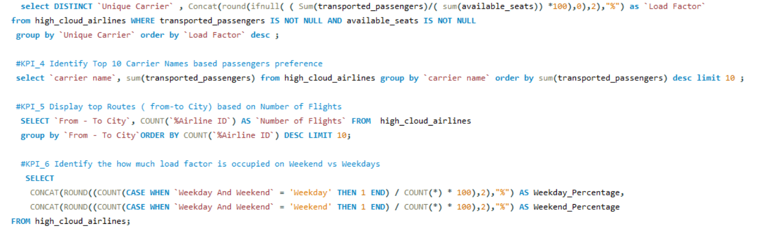
SQL QUERY VISUAL

Slide 13
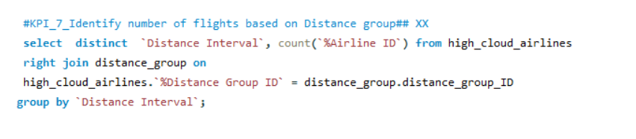
SQL QUERY VISUAL

Slide 14
EXCEL KPI
KPI : COUNT OF PASSENGERS ON WEEKDAYS AND WEEKENDS
INSIGHTS :
In this KPI, We have found that the passengers preferred to travel more on weekdays instead on weekends. So here, 71% passengers have been travelled yet on weekdays and 28.74% passengers have been chosen to travel on weekend.
RECOMMENDATIONS:
Some marketing strategies need to be implemented like discounts given specifically on weekends to promote passengers to choose travel more on weekends.
Allow children to travel free with their parents to attract more passengers on weekends.
Provide free food while travelling can also boost the numbers of passengers on the weekends.

Slide 15
POWER BI KPI
TOP 10 COUNT OF FLIGHTS BY DISTANCE GROUPS
INSIGHTS :
In this KPI, We have discovered that 58033 are the total highest number flights have been operated between 0 to 500 miles distance among top 10. On the other hand, 524 are the total lowest number of flights which have been travelled between 3500 to 4999 Miles distance so far.
RECOMMENDATIONS:
More number of flights must be aligned and operated between 1000- 4999 miles.
More number of bookings needed to align the flights to cover this much distance.
Some advertising strategy should be implemented like display the tourists pictures of the various countries which come under this much distance to travel. It will encourage the passengers to visit and explore these places. Automatically, it will also increase the number of flights that can travel up to these distances.
Make the lists of countries that come under in these distances and showcase the alluring pictures and information that can be seen by the passengers. Attract and encourage them to travel those countries with minimal price and with proper tourists guidance.

Slide 16
TABLEAU KPI
KPI : TOP 10 COUNT OF AIRLINES BY LOAD FACTOR
INSIGHTS :
In this KPI, We have observed that the “Globespan Airways and the “Allegiant Airways” have the highest and second highest number of load factors that is 94.76 and 89.36 out of top 10.Whereas, “Jet Airways” and “ Air Berlin PLC” have the lowest and the least number of load factors which are 83.47 and 84.43 .
RECOMMENDATIONS:
A high load factor indicates that more seats are filled, which generally means better profitability for the airline.
The more passengers travel the more it will be better, but try to improve the luggage services like provides safety and security to the passengers, gives their luggage on time and mention the specific place to collect it on the label as well. Try to inform them through announcements. It will create a long -lasting impression on the customers mind and their perspective would get strong to travel more.

Slide 17
SQL KPI
KPI : TOP 10 CARRIERS NAME BY PASSENGERS
INSIGHTS:
In this KPI, We have noticed that the highest number of passengers have been travelled in “Delta Airways”. On the other hand, the lowest number of passengers have been travelled in “American Eagle”carrier.
KPI: COUNT OF FLIGHTS FROM-TO-CITY
INSIGHTS:
In this KPI, we have tried to find that there are 9700 flights which have been operated domestically. However, only 13000 flights have been travelled Internationally.
RECOMMENDATIONS:
More services need to be added and upgraded the existing one to attract more bookings for the International flights.

Slide 18


Thank YOU

